Slide 1
Subject Name :TRANSMISSION LINES AND RF SYSTEM Presentation Title: Classification of Underground Cables
JEPPIAAR INSTITUTE OF TECHNOLOGY
“Self-Belief | Self Discipline | Self Respect”
Department of Electronics and Communication Engineering
Team Members:
Students Name: Reg No:
1. ADITHYAN 210617106001
2. RAJ 210617106065
3. THENNARASU 210617106079
4. SIVA 210617106075
5. KARUNYA 210617106047
6. DIVYA 210617106027

Slide 2
CONTENT
Underground system introduction
Underground cables
Cable structure
Construction of cables
Classification of cables
Properties of insulating materials
Insulating materials for cables
Advantages
Disadvantages

Slide 3
INTRODUCTION
Electric power can be transmitted or distributed either by overhead system or by underground cables.
The underground system of electrical distribution of power in large cities in increasingly being adopted.
Although it is costly system of distribution as compared to overhead system

Slide 4
UNDERGROUND CABLES
An underground cable consist of one or more conductors covered with some suitable insulating material and surrounded by a protecting cover.
The interference from external disturbances like storms ,lightening ,trees should be reduced to achieve trouble free service.
The cables may be buried directly in the ground , or may be installed in ducts buried in the ground

Slide 5
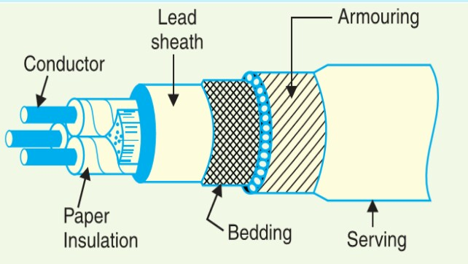
CONSTRUCTION OF CABLES

Slide 6
CONSTRUCTION OF CABLES
The various parts cable are
Cores or conductors
Insulation
Metallic sheath
Bedding
Armouring
Serving

Slide 7
CLASSIFICATION OF CABLES
Low tension
High tension
Super tension
Extra high tension
Extra super voltage cables

Slide 8
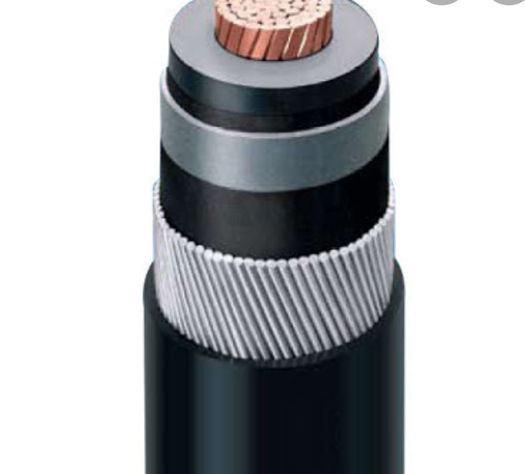
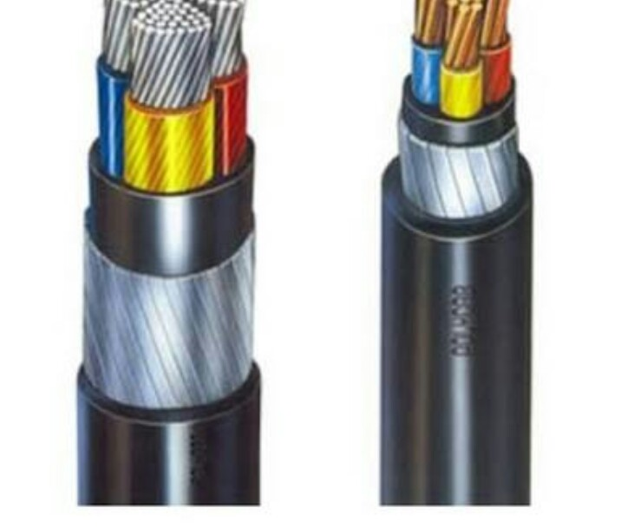
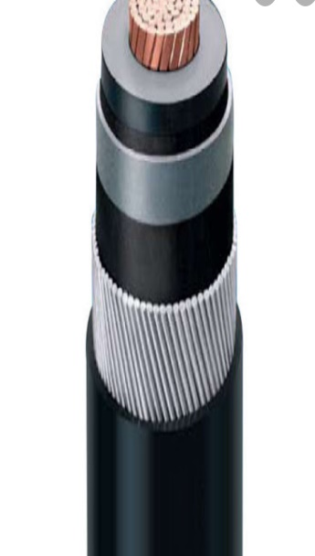
HIGH TENSION CABLE
LOW TENSION CABLE
LOW TEI

Slide 9
PROPERTIES OF INSULATING MATERIAL
High resistivity
High dielectric
High mechanical strength
Capability to withstand high rupturing voltage
High tensile strength and plasticity

Slide 10
INSULATING MATERIALS FOR CABLES
Rubber
XLPE cable
Vulcanized India rubber
Impregnated paper
Varnished cambric
Polyvinyl chloride(PVC)

Slide 11
ADVANTAGES
Better general appearance.
Less liable to damage through storms or lighting.
low maintenance cost.
Less chance of faults.
Small voltage drops.

Slide 12
DISADVANTAGES
The cost of underground cables are high.
They introduce insulation problem at high voltages compared with the equivalent overhead system.
Capacitance and charging current is high in case of underground cables.
So that for long distance power transmission the charging current is very high results in over voltages problems.

Slide 13
FUTURE SCOPE
In coming years there is an increasing demand for high voltage cables in the regions of North America and Europe.
It evaluates the financial outlooks of these companies , their research and development statuses and their expansion strategies for the coming years.

Slide 14
REFERENCE
RF Microelectronics, second edition ed. prentice hall,2011
Roshan and Jonathan Leary.
D.K. Shaeffer and T.H. Lee

